Slide 2
Language pack
Sever
Client
reload page
CGI do multi-lingo
Language pack
Sever
Client
Reload language pack (Ajax)
javascript do multi-lingo

Slide 3
Timing -init
init
html file
Load 語言包
Dom objects
翻譯字串
parse
Dom ready
<html>
// Load 語言包
<script type="text/javascript">
  $(function(){
  // 翻譯字串
  …
  })
</script>
<body >
…
</body>
</html>
Dom ready
parse

Slide 4
Timing -update, modify & add
update
Dom objects
改變語言
Load 語言包
翻譯字串
parse
Dom ready
Modify & add
Load 語言包
Dom objects
改變Dom
翻譯字串 (partial)
parse
Dom ready
Dom ready
modify
add

Slide 5
Timing (abandon)
Document.write (字串變數)
html file
Load 語言包
翻譯字串
翻譯字串
翻譯字串
parse
Dom ready
Load 語言包
改變Dom
Dom objects
翻譯字串
Document.write(…)
parse
Dom ready
Dom ready
add

Slide 6
Method –init (1/2)
1. Define lingual data (json)
en
cht
2. Add lingo attribute in html tag
{
‘key’: ‘value’,
‘key2’: ‘value2’,
…
}
{
‘key’: ‘值一’,
‘key2’: ‘值二’,
…
}
<span lingo=‘key’ lingoTitle = ‘key 2’ ><span>
init
html file
Load 語言包
Dom objects
翻譯字串
parse
Dom ready

Slide 7
Method –init (2/2)
3. Load & Setting plugin
4. Apply plugin
<script src="zyMultiLingo.js" type="text/javascript"></script>
var $lingoObj = $.zyMultiLingo(lingoOption);
var lingoOption = {
  DLingo: 'EN',
  lingos:[
    {id : 'EN', src : "lingo-en.js"},
    {id :'CHT', src : "lingo-cht.js"},
    {id :'CN', src : "lingo-cn.js"}
  ]
};
After onload …
EN: <span lingo=‘key’>value<span>
CHT: <span lingo=‘key’>值<span>
init
html file
Load 語言包
Dom objects
翻譯字串
parse
Dom ready

Slide 8
Method -update
Use update( lingoID )
function onChangeLingo (lingoID)
{
$lingoObj.update(lingoID);
}
update
Dom objects
改變語言
Load 語言包
翻譯字串
parse
Dom ready

Slide 9
Method -modify
2. Use refresh( obj )
1. Set lingo attribute
$lingoObj.refresh( $target );
$target .attr('lingo', key);
OR
2. Use T(key)
$target.html( $lingoObj.T(key) );
$target : jQuery obj
Load 語言包
Dom objects
改變Dom
翻譯字串 (partial)
modify
parse
Dom ready
$target
Dom ready
modify

Slide 10
Method -add
2. Use refresh( obj )
1. Set lingo attribute
$lingoObj.refresh( $target );
$target .attr('lingo', key);
OR
2. Use T(key)
$target.html( $lingoObj.T(key) );
$target : jQuery obj
Load 語言包
Dom objects
改變Dom
翻譯字串 (partial)
add
parse
Dom ready
Dom ready
add
$target

Slide 11
Method –ajax add
Add lingo attribute in content
<span lingo=‘key’ > <span>
Load 語言包
Dom objects
改變Dom
翻譯字串 (partial)
ajax add
parse
Dom ready
Dom ready
Ajax add
$target

Slide 12
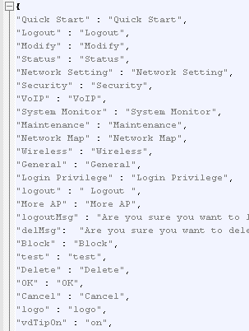
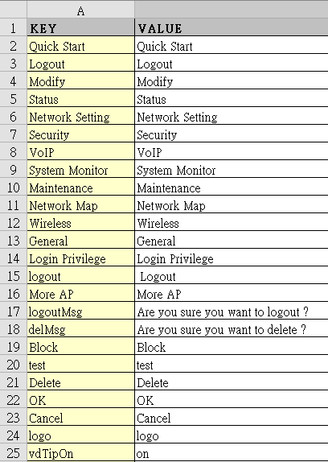
Tool –json2excel, excel2json
Json
Excel

